Slide 1
REACT JS

Slide 2
agenda
SPA Benefits
React and its working
React Components
Props
State
Features of ES6

Slide 3
agenda
JSX
Events
Conditional Rendering
List
Keys
Map

Slide 4
agenda
React Forms
Form Validations
Handling Errors in React
Consuming Rest API

Slide 5
React basics
React is a JavaScript library for building user interfaces.
React is used to build single page applications.
React allows us to create reusable UI components.
A single-page application is a web application or website that interacts with the user by dynamically rewriting the current web page with new data from the web server, instead of the default method of the browser loading entire new pages

Slide 6

React features

Slide 7
JSX
JSX stands for JavaScript XML. It is a JavaScript syntax extension. Its an XML or HTML like syntax used by ReactJS.
This syntax is processed into JavaScript calls of React Framework. It extends the ES6 so that HTML like text can co-exist with JavaScript react code.
It is not necessary to use JSX, but it is recommended to use in ReactJS.

Slide 8
Components
ReactJS is all about components. ReactJS application is made up of multiple components, and each component has its own logic and controls.
These components can be reusable which help you to maintain the code when working on larger scale projects.
Two types of Components:
Class
Functional

Slide 9
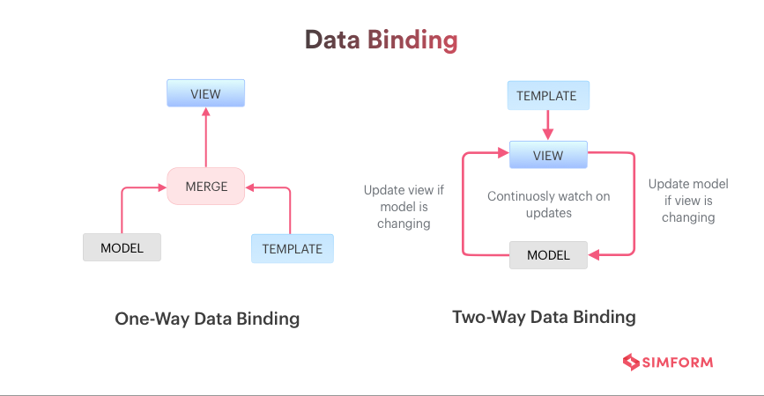
data binding

Slide 10
One way Data binding
ReactJS is designed in such a manner that follows unidirectional data flow or one-way data binding.
The benefits of one-way data binding give you better control throughout the application.
If the data flow is in another direction, then it requires additional features. It is because components are supposed to be immutable and the data within them cannot be changed.
Flux is a pattern that helps to keep your data unidirectional. This makes the application more flexible that leads to increase efficiency.

Slide 11
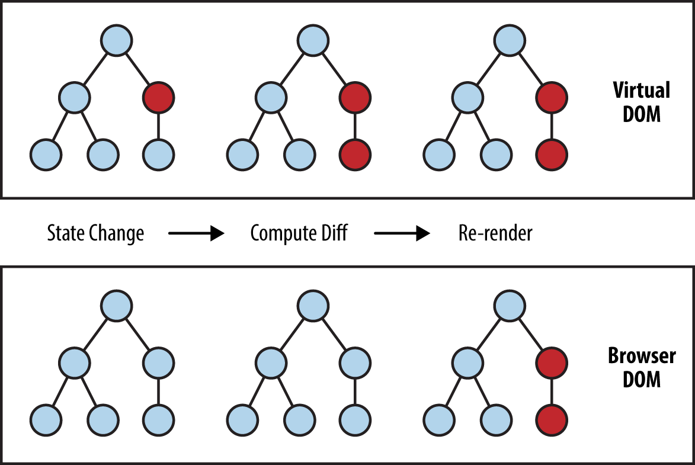
Virtual dom

Slide 12
Virtual dom
A virtual DOM object is a representation of the original DOM object. It works like a one-way data binding.
Whenever any modifications happen in the web application, the entire UI is re-rendered in virtual DOM representation.
Then it checks the difference between the previous DOM representation and new DOM. Once it has done, the real DOM will update only the things that have actually changed.
This makes the application faster, and there is no wastage of memory.

Slide 13
performance
ReactJS is known to be a great performer. This feature makes it much better than other frameworks out there today.
The reason behind this is that it manages a virtual DOM. The DOM is a cross-platform and programming API which deals with HTML, XML or XHTML.
The DOM exists entirely in memory. Due to this, when we create a component, we did not write directly to the DOM.
Instead, we are writing virtual components that will turn into the DOM leading to smoother and faster performance.

Slide 14
Disadvantages of react js
High pace of Development – new features are introduced very often
Poor Documentation
View part of MVC is only handled
JSX is a barrier – Complex to learn (HTML + XML)

Slide 15
Angular Vs React
Author | Google | Facebook Community
Developer | Misko Hevery | Jordan Walke
Initial Release | October 2010 | March 2013
Latest Version | Angular 1.7.8 on 11 March 2019. | React 16.8.6 on 27 March 2019
Language | JavaScript, HTML | JSX
Type | Open Source MVC Framework | Open Source JS Framework
Rendering | Client-Side | Server-Side
Packaging | Weak | Strong
Data-Binding | Bi-directional | Uni-directional

Slide 16
Angular Vs React
DOM | Regular DOM | Virtual DOM
Testing | Unit and Integration Testing | Unit Testing
App Architecture | MVC | Flux
Dependencies | It manages dependencies automatically. | It requires additional tools to manage dependencies.
Routing | It requires a template or controller to its router configuration, which has to be managed manually. | It doesn't handle routing but has a lot of modules for routing, eg., react-router.
Performance | Slow | Fast, due to virtual DOM.
Best For | It is best for single page applications that update a single view at a time. | It is best for single page applications that update multiple views at a time.

Slide 17
components
A Component is considered as the core building blocks of a React application. It makes the task of building UIs much easier. Each component exists in the same space, but they work independently from one another and merge all in a parent component, which will be the final UI of your application.
Every React component have their own structure, methods as well as APIs. They can be reusable as per your need. For better understanding, consider the entire UI as a tree. Here, the root is the starting component, and each of the other pieces becomes branches, which are further divided into sub-branches.

Slide 18
Class components
Class components are more complex than functional components. It requires you to extend from React.
Component and create a render function which returns a React element. You can pass data from one class to other class components.
You can create a class by defining a class that extends Component and has a render function.
The class component is also known as a stateful component because they can hold or manage local state.

Slide 19
Functional components
In React, function components are a way to write components that only contain a render method and don't have their own state. They are simply JavaScript functions that may or may not receive data as parameters. We can create a function that takes props(properties) as input and returns what should be rendered. A valid functional component can be shown in the below example.
function WelcomeMessage(props) {
return <h1>Welcome to the , {props.name}</h1>;
}
The functional component is also known as a stateless component because they do not hold or manage state. It can be explained in the below example.

Slide 20
Component lifecycle
Every component creation process involves various lifecycle methods. These lifecycle methods are termed as component's lifecycle.
These lifecycle methods are not very complicated and called at various points during a component's life. The lifecycle of the component is divided into four phases. They are:
Initial Phase
Mounting Phase
Updating Phase
Unmounting Phase

Slide 21
constructor
The constructor is a method used to initialize an object's state in a class. It automatically called during the creation of an object in a class.
The concept of a constructor is the same in React. The constructor in a React component is called before the component is mounted. When you implement the constructor for a React component, you need to call super(props) method before any other statement. If you do not call super(props) method, this.props will be undefined in the constructor and can lead to bugs.

Slide 22
constructor
In React, constructors are mainly used for two purposes:
It used for initializing the local state of the component by assigning an object to this.state.
It used for binding event handler methods that occur in your component.
In React, constructors are mainly used for two purposes:
It used for initializing the local state of the component by assigning an object to this.state.
It used for binding event handler methods that occur in your component.

Slide 23
React state
The state is an updatable structure that is used to contain data or information about the component. The state in a component can change over time.
They are also responsible for making a component dynamic and interactive.
It can be set by using the setState() method and calling setState() method triggers UI updates. A state represents the component's local state or information.
It can only be accessed or modified inside the component or by the component directly. To set an initial state before any interaction occurs, we need to use the getInitialState() method.

Slide 24
React state
To define a state, first declare a default set of values for defining the component's initial state.
To do this, add a class constructor which assigns an initial state using this.state. The 'this.state' property can be rendered inside render() method.
To set the state, it is required to call the super() method in the constructor. It is because this.state is uninitialized before the super() method has been called.

Slide 25
React props
Props stand for "Properties." They are read-only components. It is an object which stores the value of attributes of a tag and work similar to the HTML attributes.
It gives a way to pass data from one component to other components.
It is similar to function arguments. Props are passed to the component in the same way as arguments passed in a function.
Props are immutable so we cannot modify the props from inside the component. Inside the components, we can add attributes called props.
These attributes are available in the component as this.props and can be used to render dynamic data in our render method.

Slide 26
State Vs Props
SN | Props | State
1. | Props are read-only. | State changes can be asynchronous.
2. | Props are immutable. | State is mutable.
3. | Props allow you to pass data from one component to other components as an argument. | State holds information about the components.
4. | Props can be accessed by the child component. | State cannot be accessed by child components.
5. | Props are used to communicate between components. | States can be used for rendering dynamic changes with the component.
6. | Stateless component can have Props. | Stateless components cannot have State.
7. | Props make components reusable. | State cannot make components reusable.
8. | Props are external and controlled by whatever renders the component. | The State is internal and controlled by the React Component itself.

Slide 27
State vs props
SN | Condition | Props | State
1. | Can get initial value from parent Component? | Yes | Yes
2. | Can be changed by parent Component? | Yes | No
3. | Can set default values inside Component? | Yes | Yes
4. | Can change inside Component? | No | Yes
5. | Can set initial value for child Components? | Yes | Yes
6. | Can change in child Components? | Yes | No

Slide 28
State and Props similarities
SN | State and Props
1. | Both are plain JS object.
2. | Both can contain default values.
3. | Both are read-only when they are using by this.

Slide 29
ES6 Features
Const and let keywords – have scope and has to be initialized before usage.
Array Helper Functions
Map
Filter
Find
Every
Some
Reduce

Slide 30
Es6 features
Arrow Functions
Classes
Object Literals
Template Strings
Default Function Arguments
Rest and Spread Operators
Destructuring
Promises

Slide 31
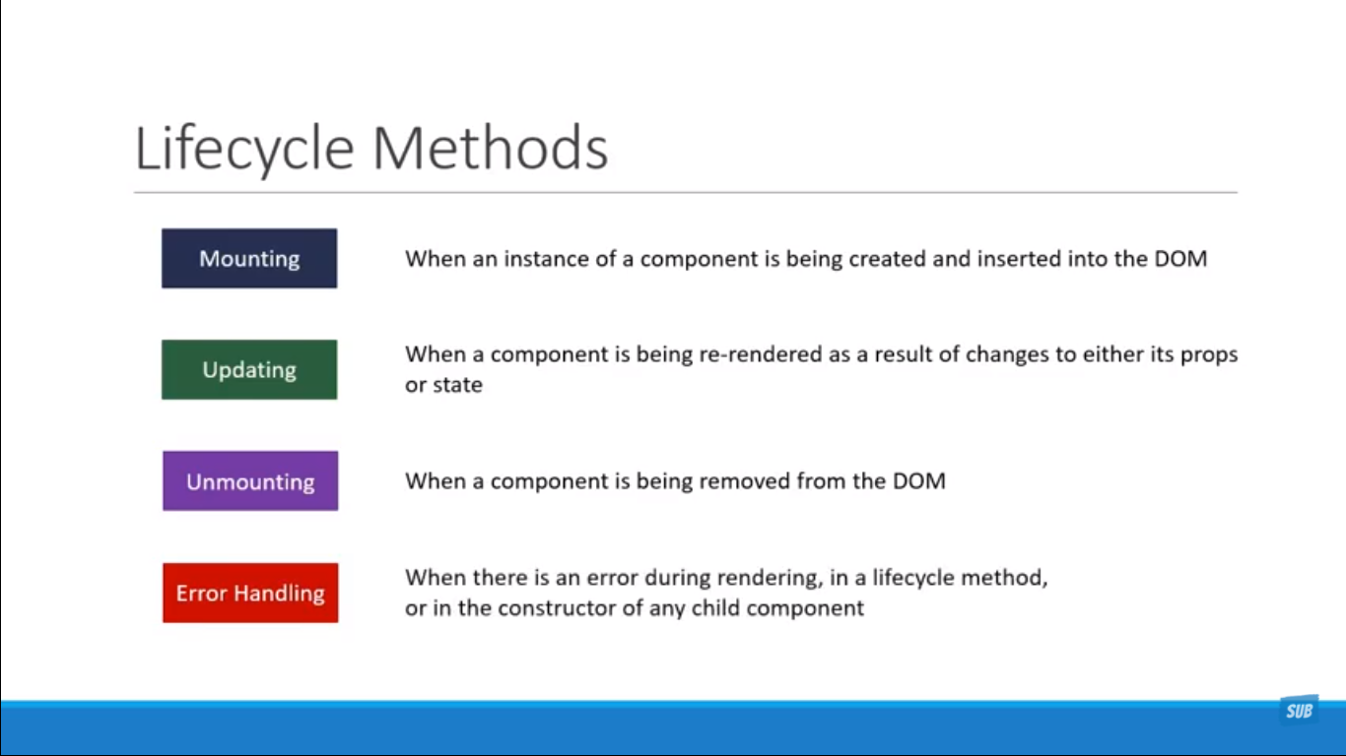
Component lifecycle

Slide 32
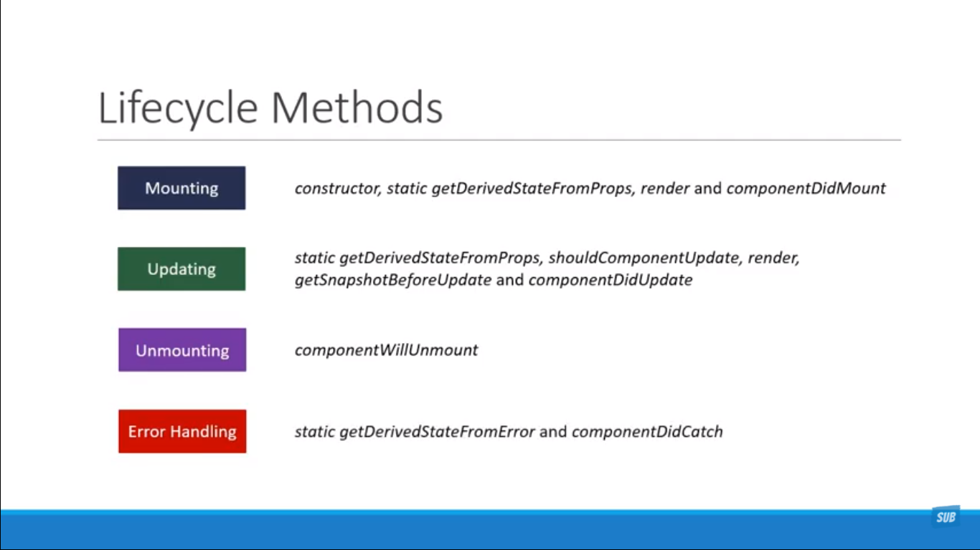

Slide 33
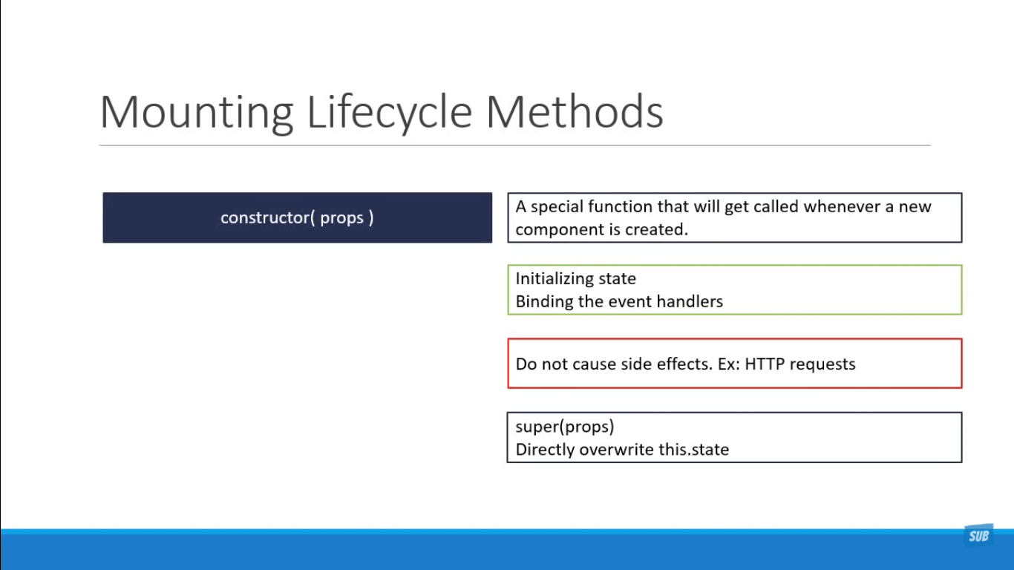

Slide 34
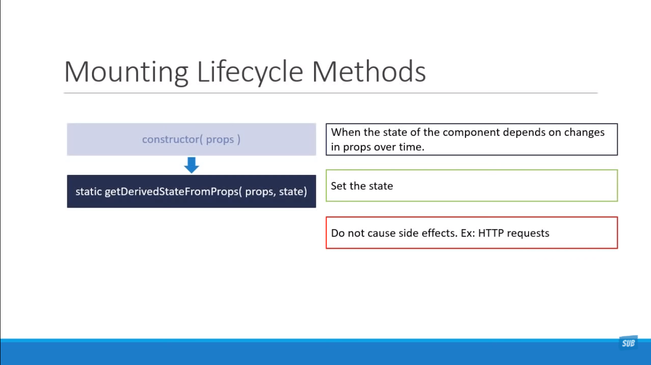

Slide 35
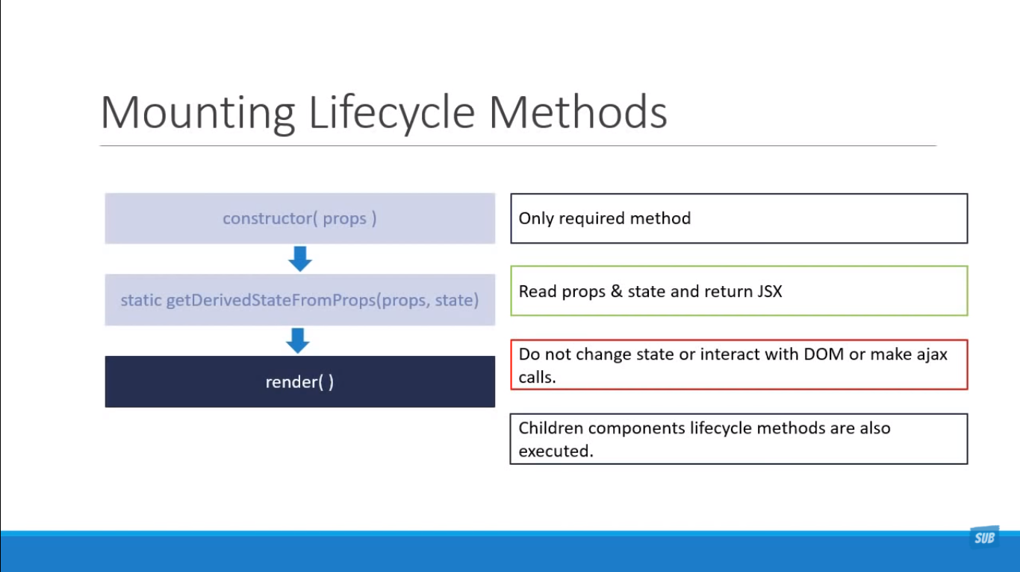

Slide 36
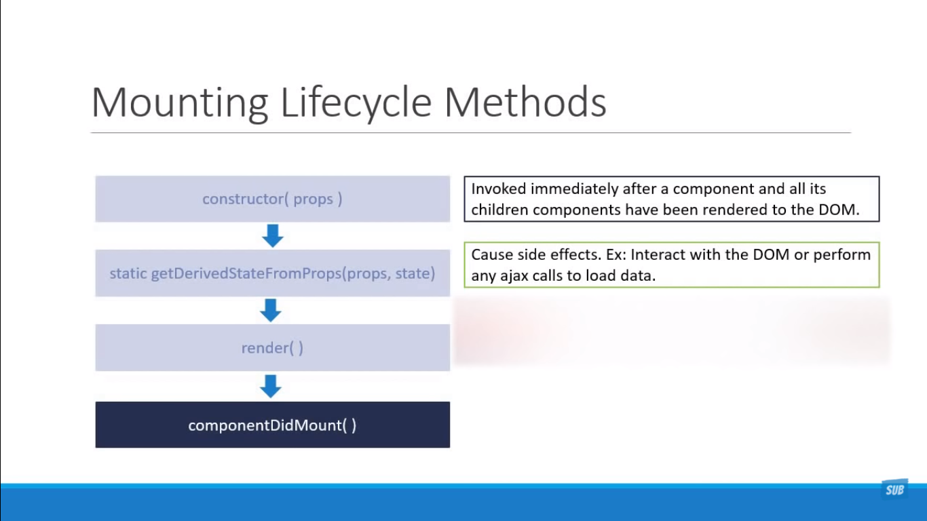

Slide 37
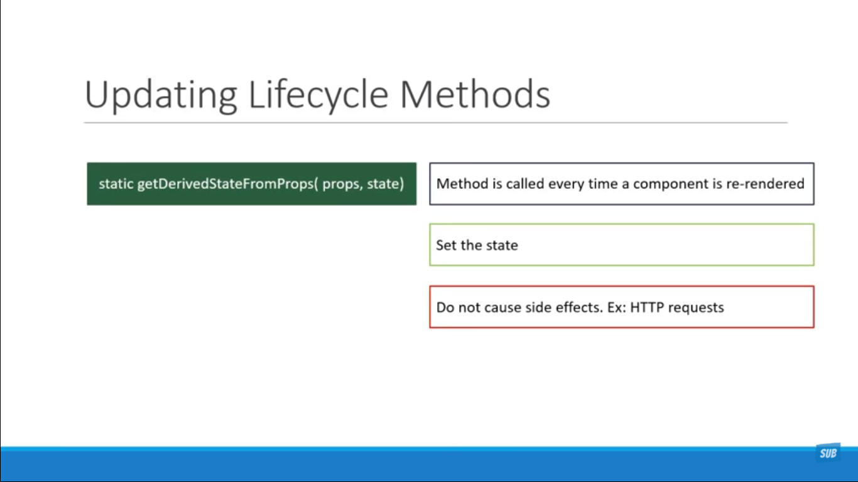

Slide 38
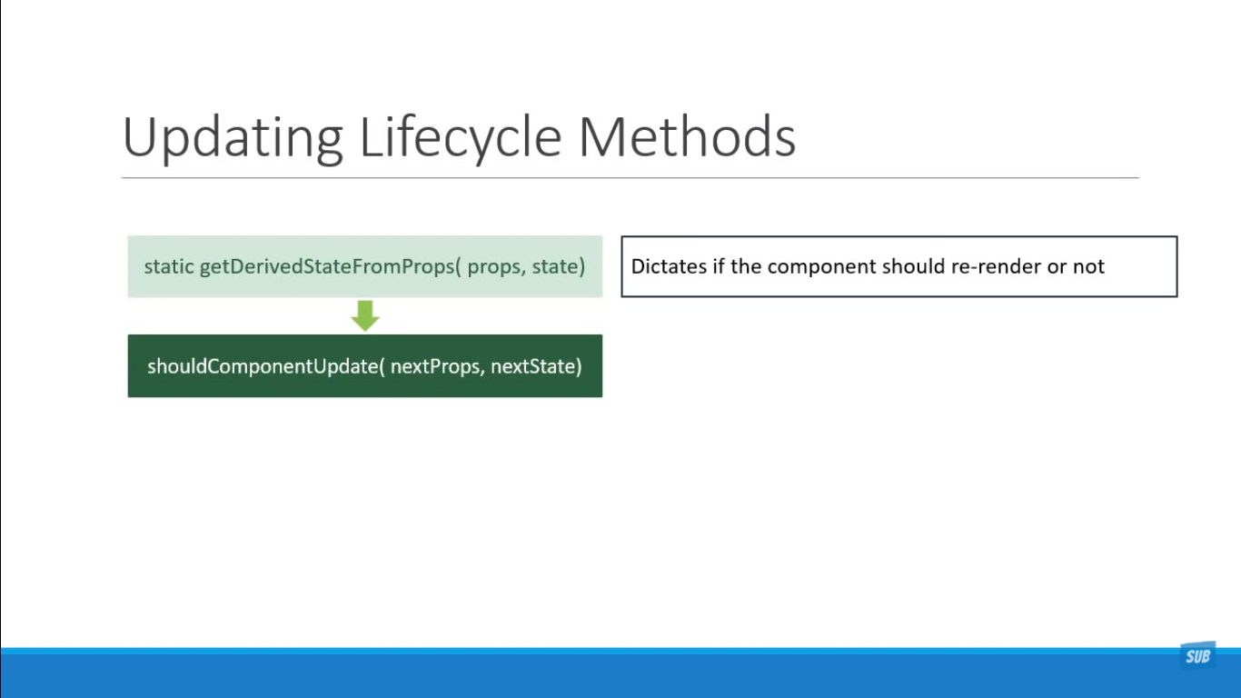

Slide 39
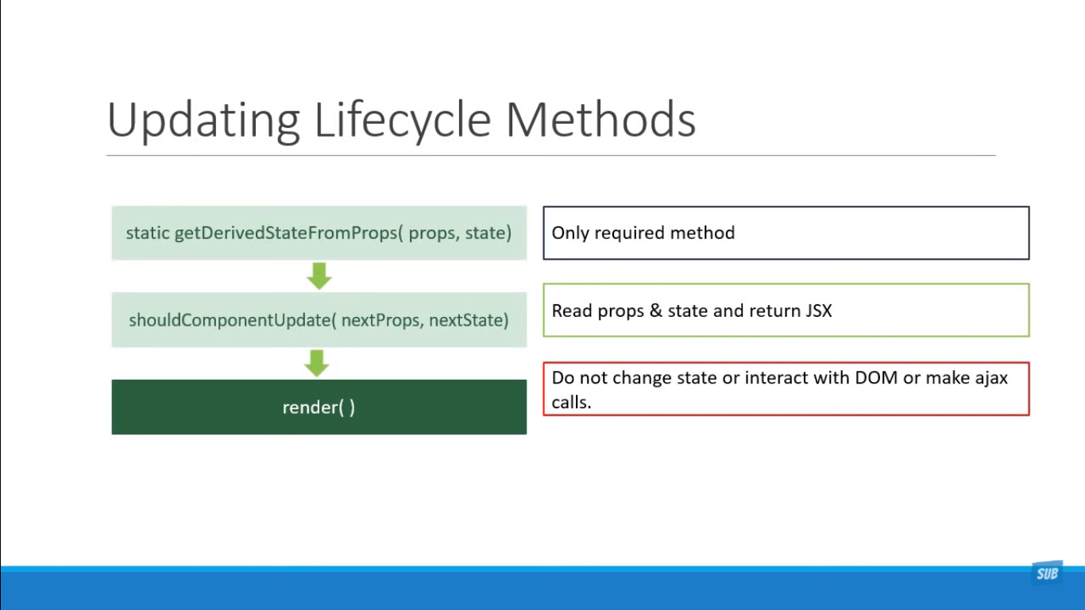

Slide 40
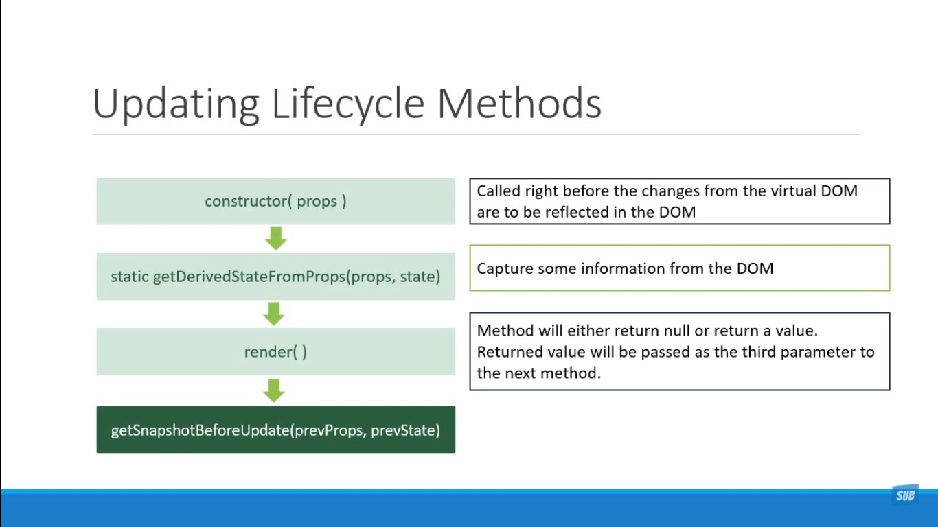

Slide 41
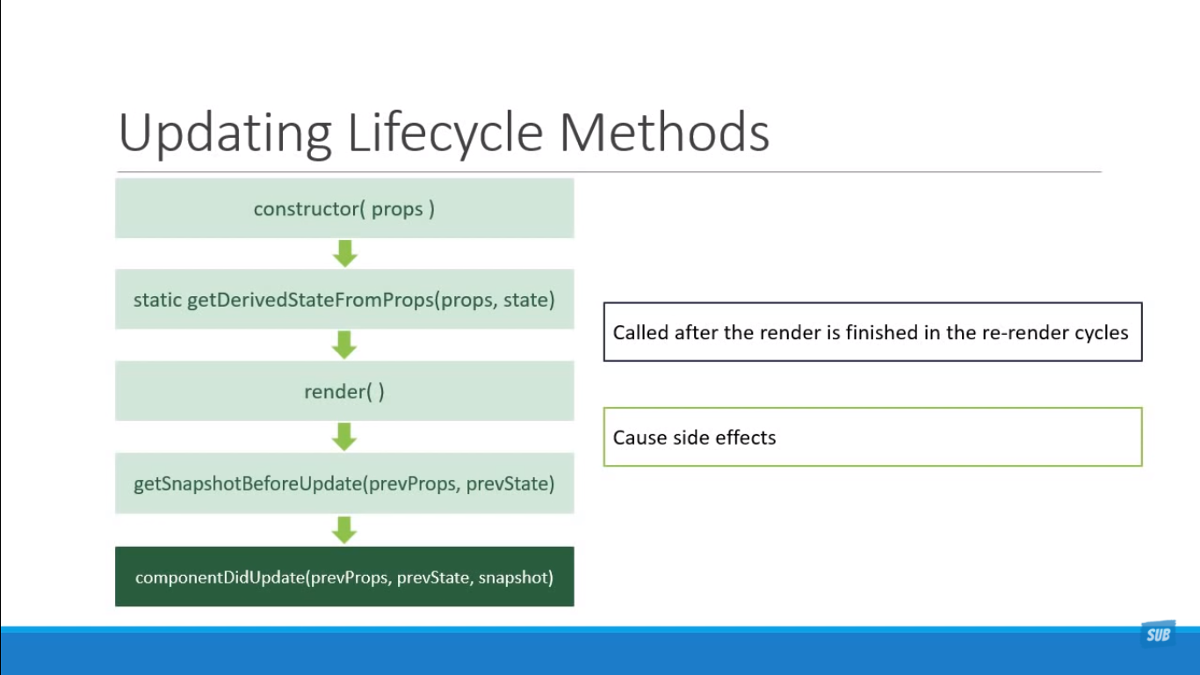

Slide 42
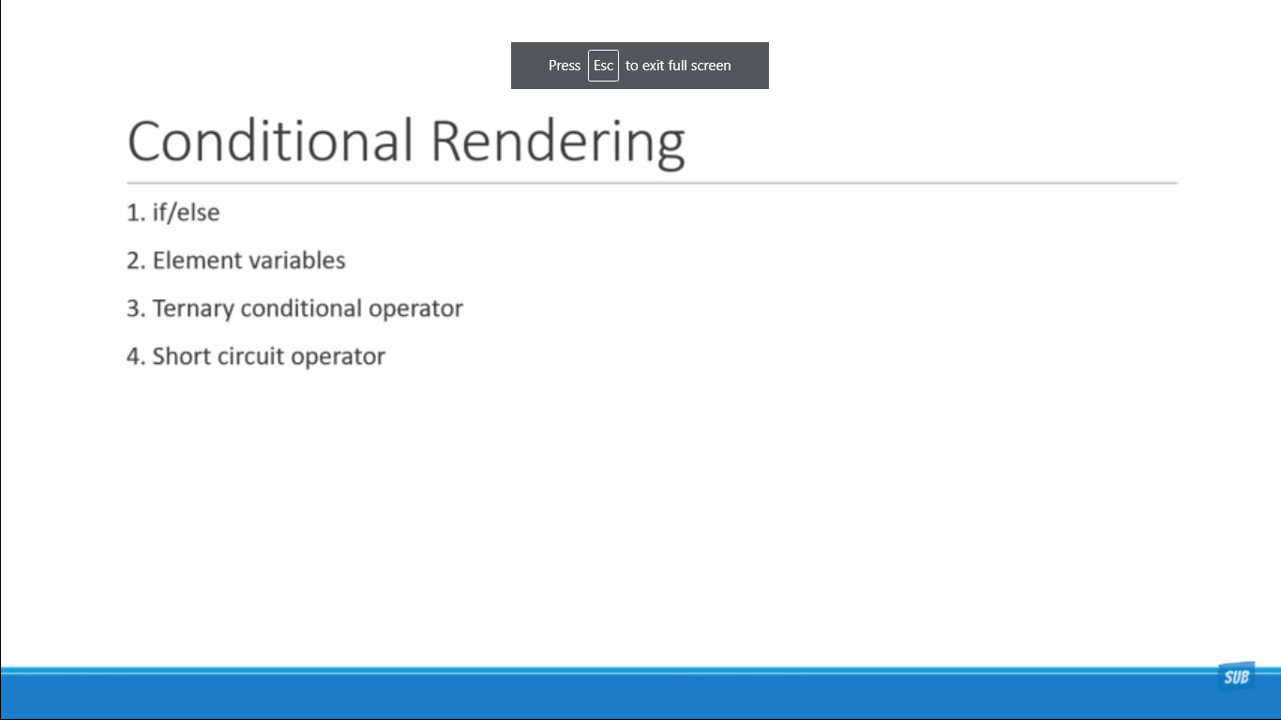

Slide 43
